Slide 1
Green Ammonia Plant Optimization Model Setup and Flow
5/22 Week

Slide 2
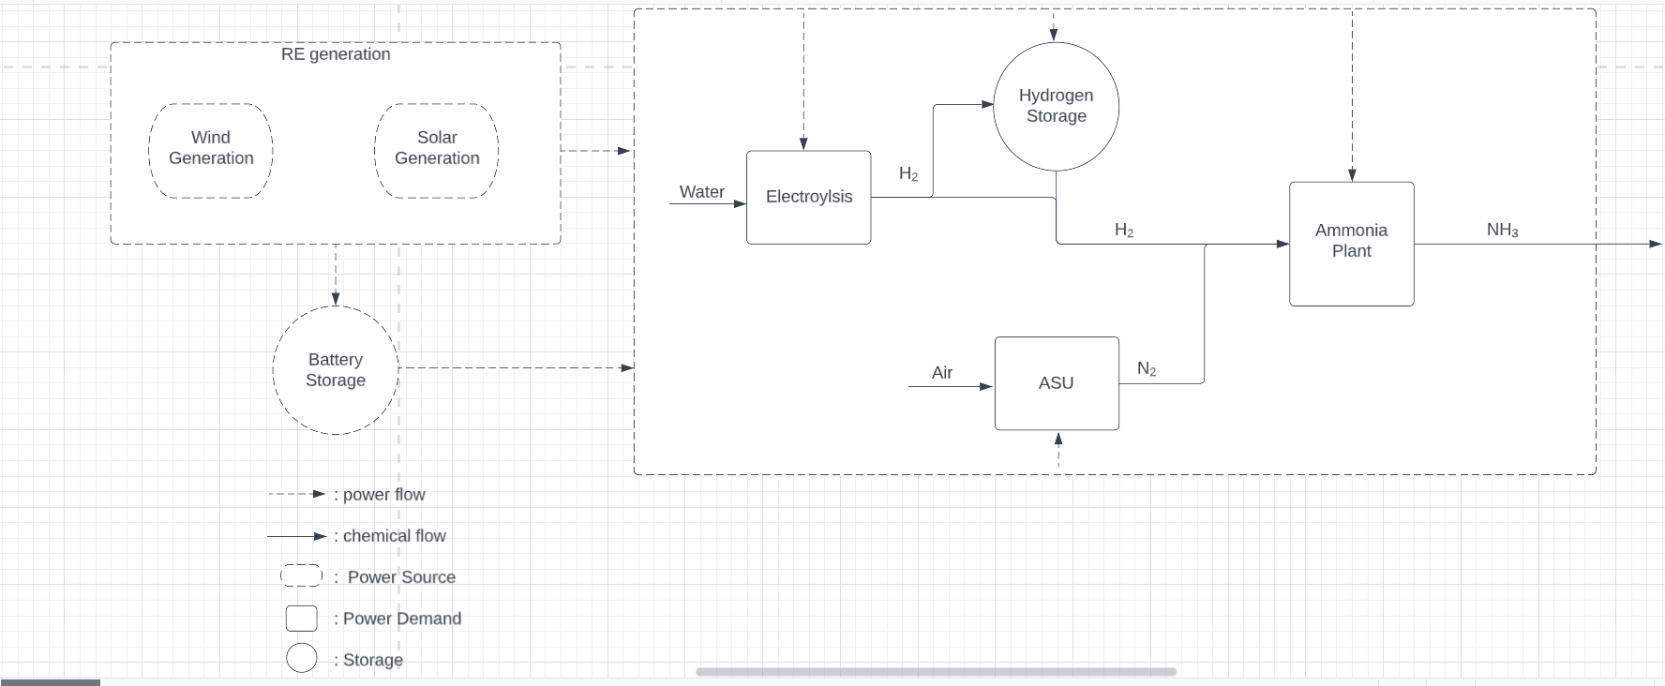

Slide 3
Model requirement 1: decide capacity of plants
Decide the capacity (how big) of plants
RE generation capacities
Battery storage size
Hydrogen storage size
Electroyzer capacity
ASU capacity
Ammonia plant capacity

Slide 4
Model requirement 2: decide operations of plants on hourly timescale
Battery storage
Charge
No flow
Discharge
Hydrogen storage
Store
No flow
Release
Electroyzer
Produce H₂
Don’t produce H₂
ASU capacity
Produce N₂
Ammonia plant capacity
Produce NH₃

